Slide 1

What’s New in Worldview
Zachary Rice
ASRC Federal
SE TIM 2018
August 29th, 2018

Slide 2
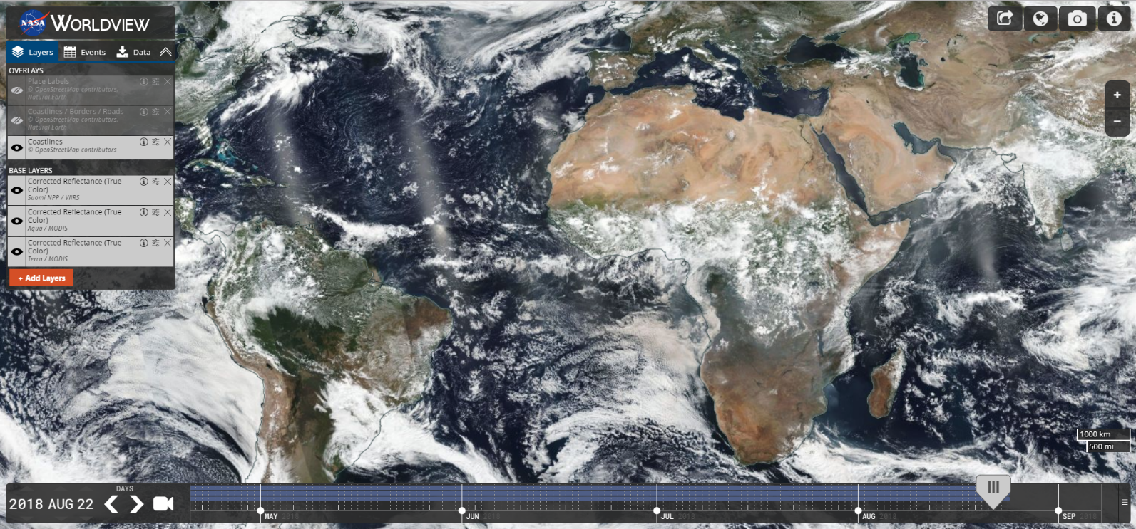




Major Releases
v2.0.0 & v2.1.0
Refactored codebase to use ES6 modules
Simplified build scripts
Improved developer tools
v2.2.0
Improved Snapshot & GIF resolution
v2.3.0
Geostationary imagery support
v2.4.0 & v2.5.0
Multi-day event tracking
v2.6.0
Natural events in polar projection views
v2.7.0
Vector layer support
v2.8.0
Support selecting layers with future dates
v2.9.0 (September 2018)
“A|B” Comparison Mode

Slide 3
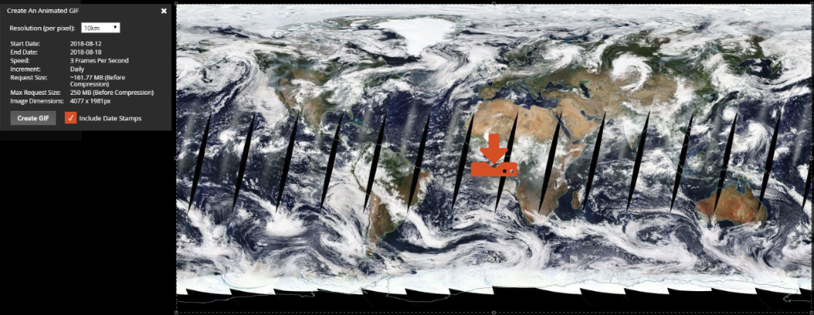
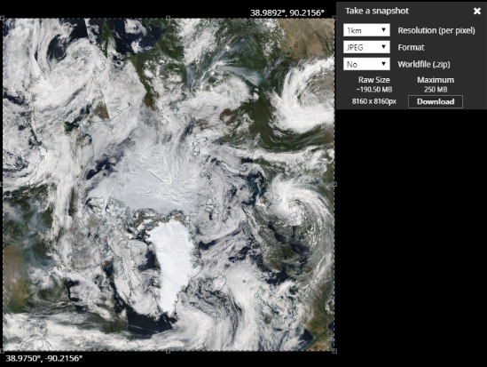
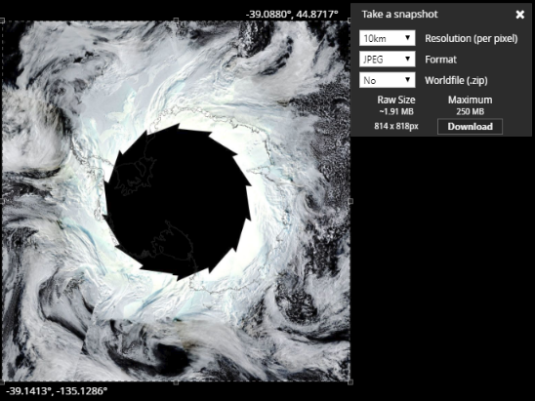
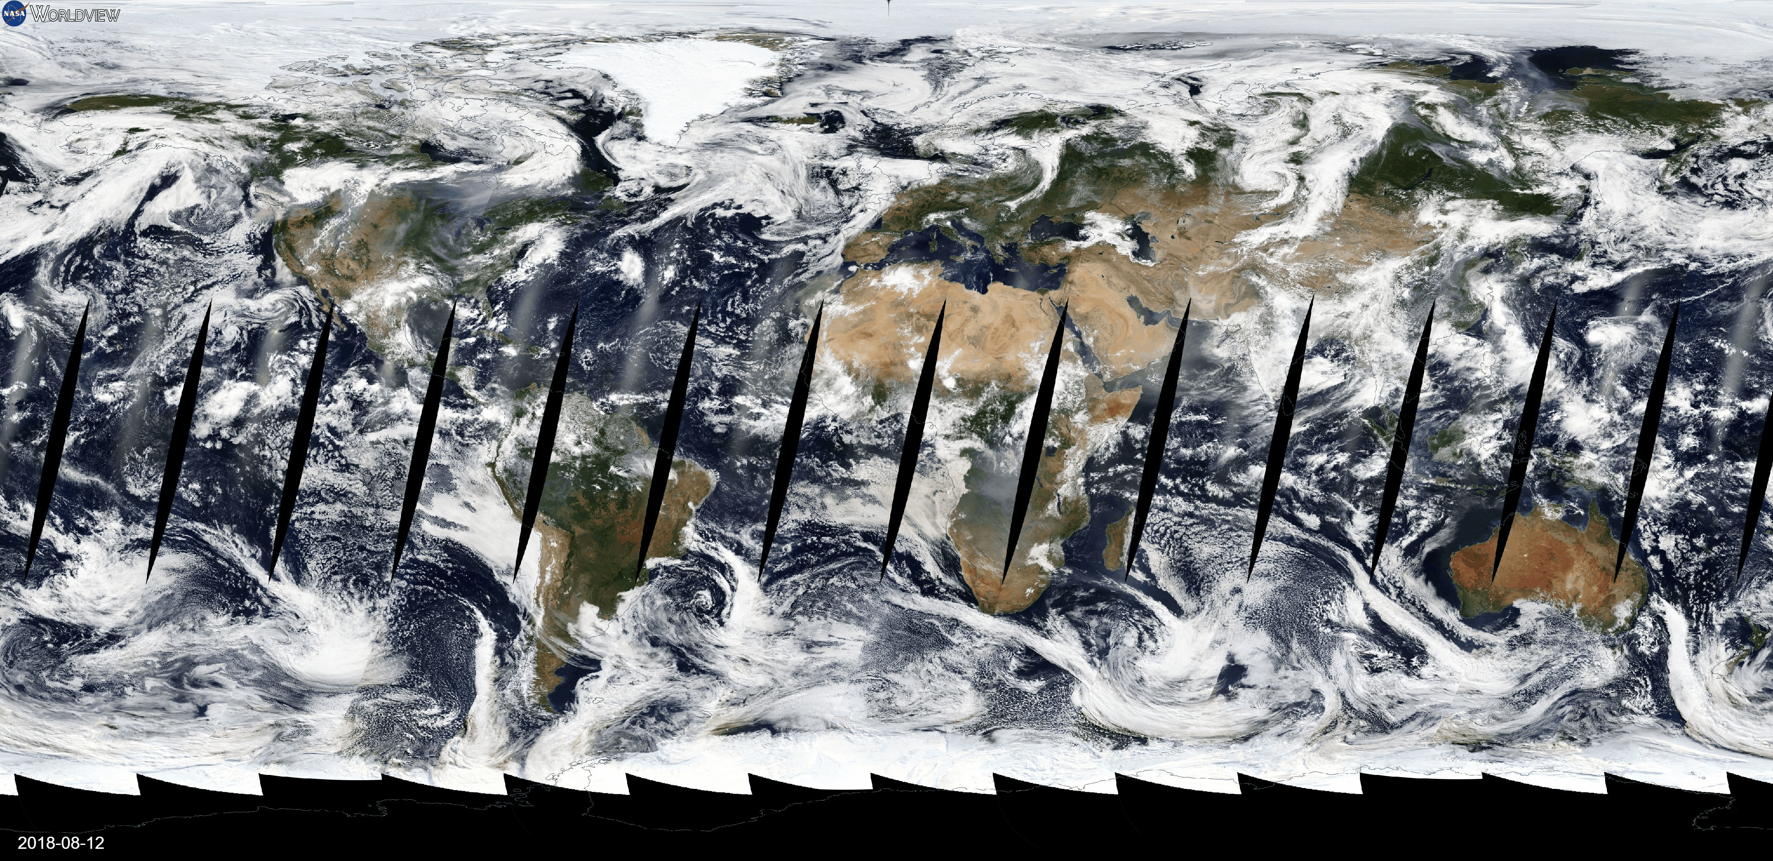
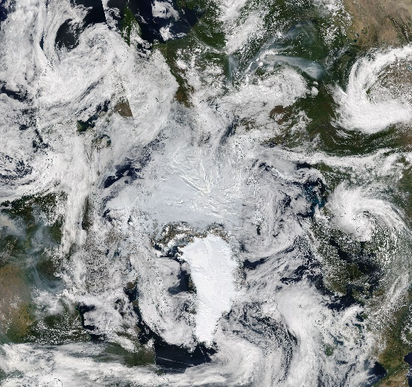
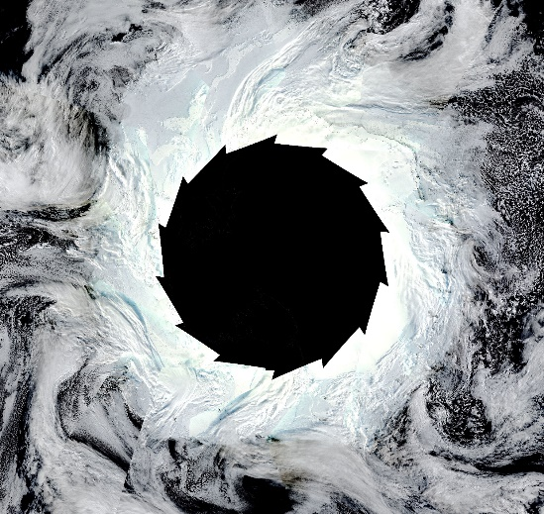
Improved Image Resolution
High-Resolution Animated GIFs
High-Resolution Image Snapshots
7-Day Animation of Geographic Projection at 10km
Arctic & Antarctic Projections at 1km

Slide 4
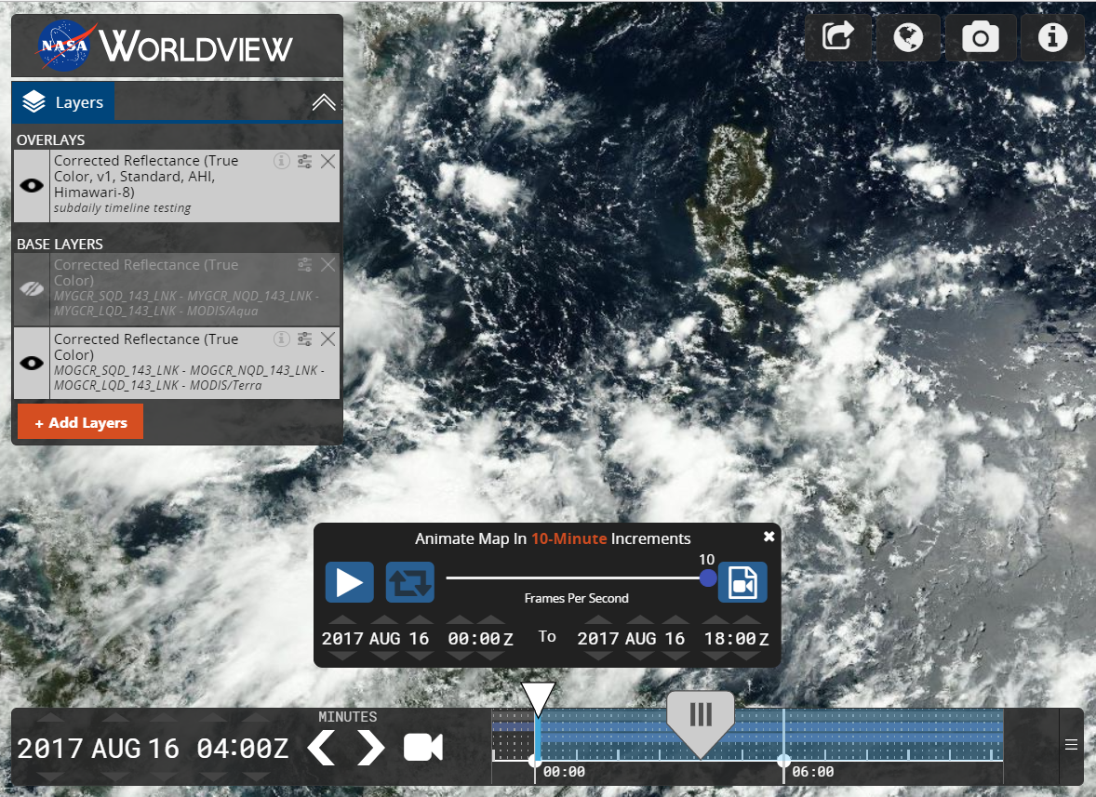
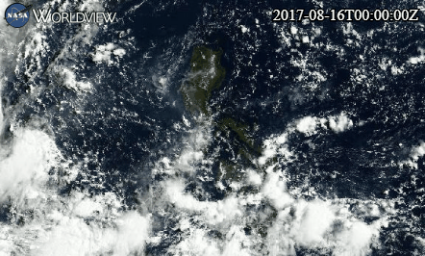
Geostationary Imagery Support
10-minute timeline granularity for NASA CAMP2Ex field campaign

Slide 5
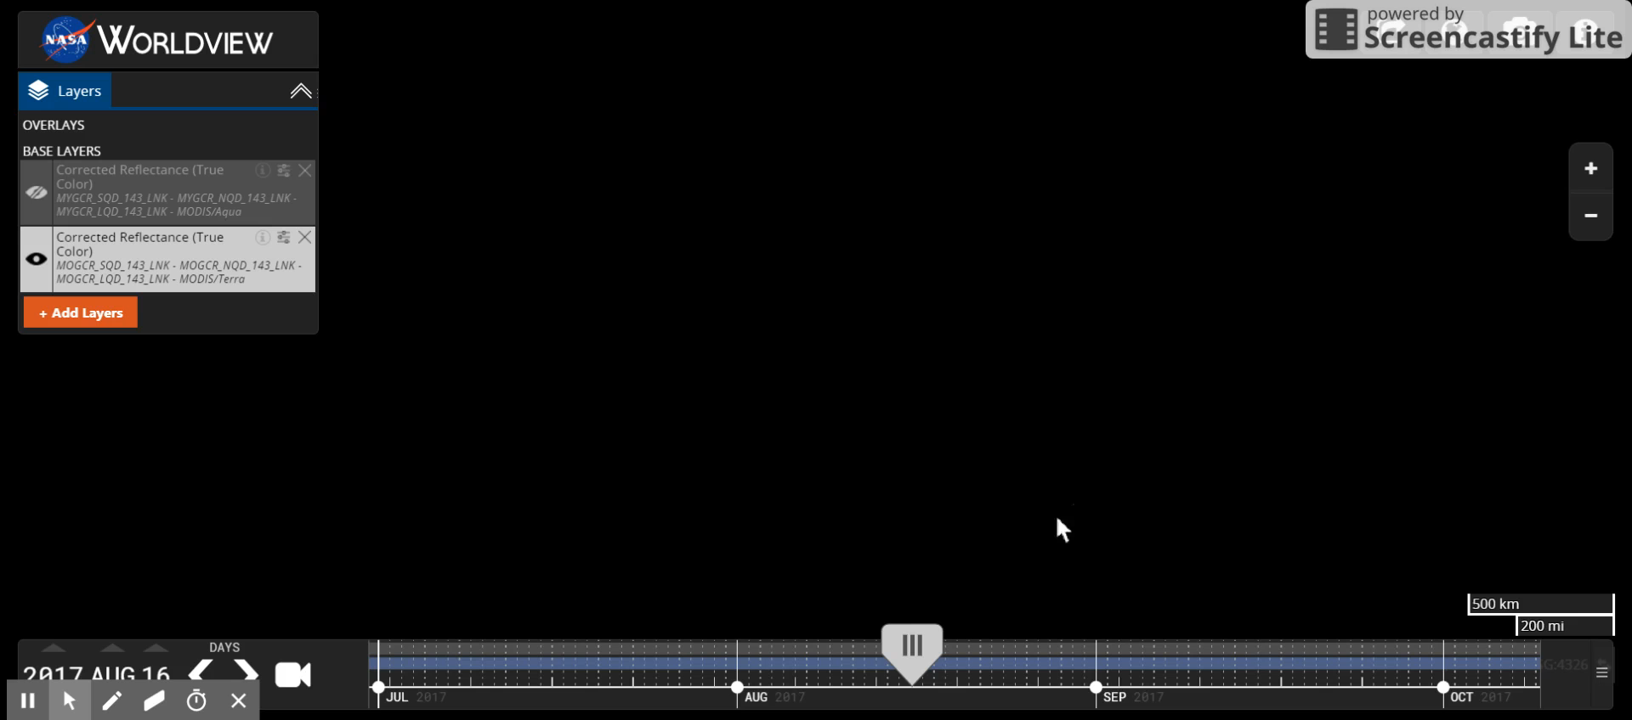
Geostationary Imagery Support

Slide 6
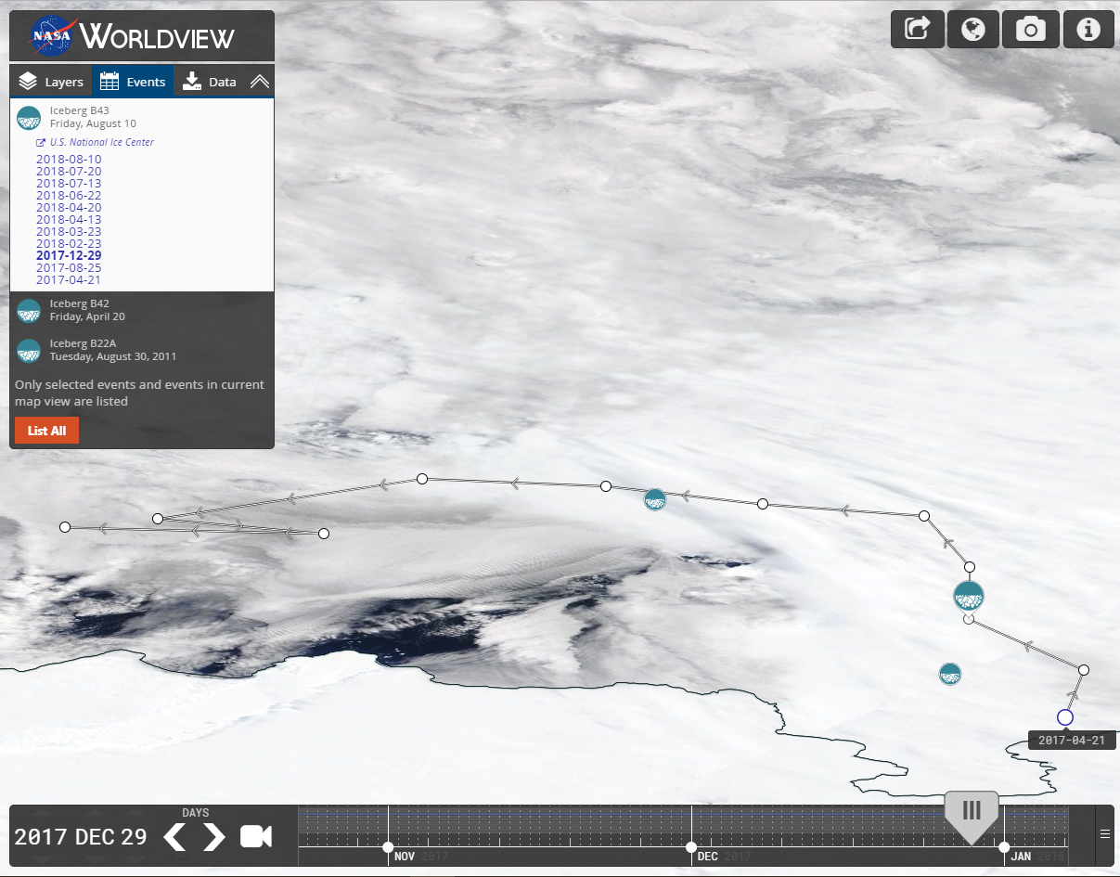
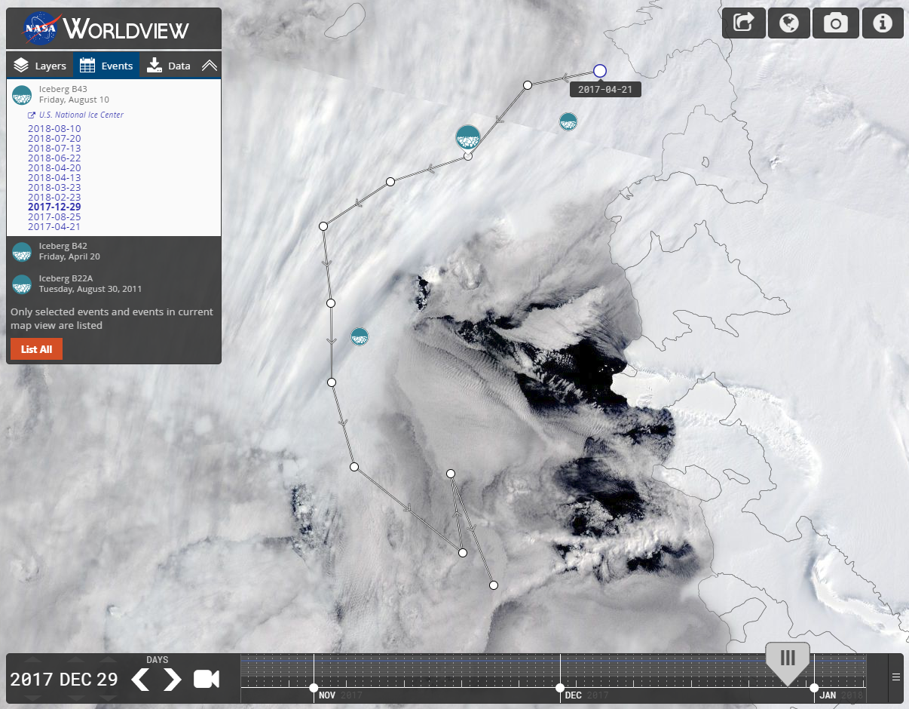
Event Tracks & Polar Events
Event Tracking
Polar Projection Support

Slide 7
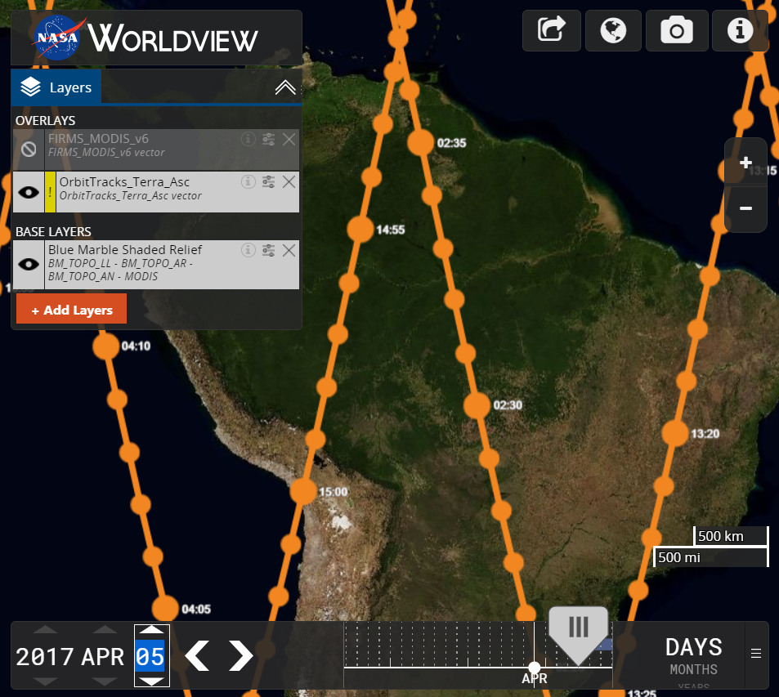
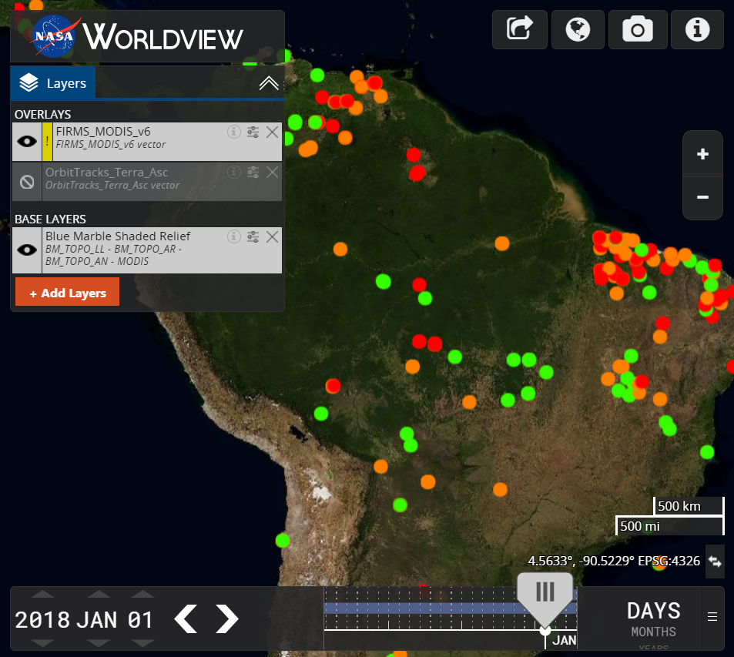
Vector Support
Orbit Tracks
FIRMS MODIS v6 Fires

Slide 8
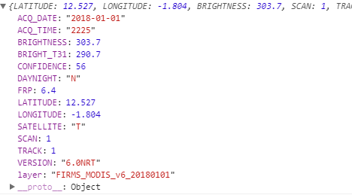
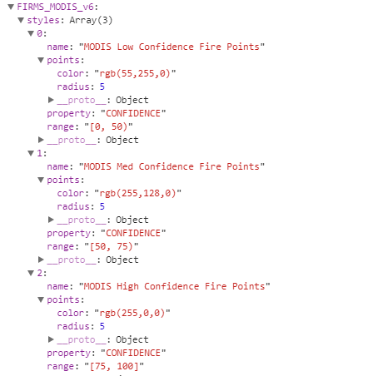
Vector Support
Composing a stylized vector layer
Vector Point Feature Data
JSON Style Data
Match vector feature data to the style JSON data
In the FIRMS_MODIS example, we match “CONFIDENCE”
Based on the CONFIDENCE number, we style with 1 of 3 colors

Slide 9
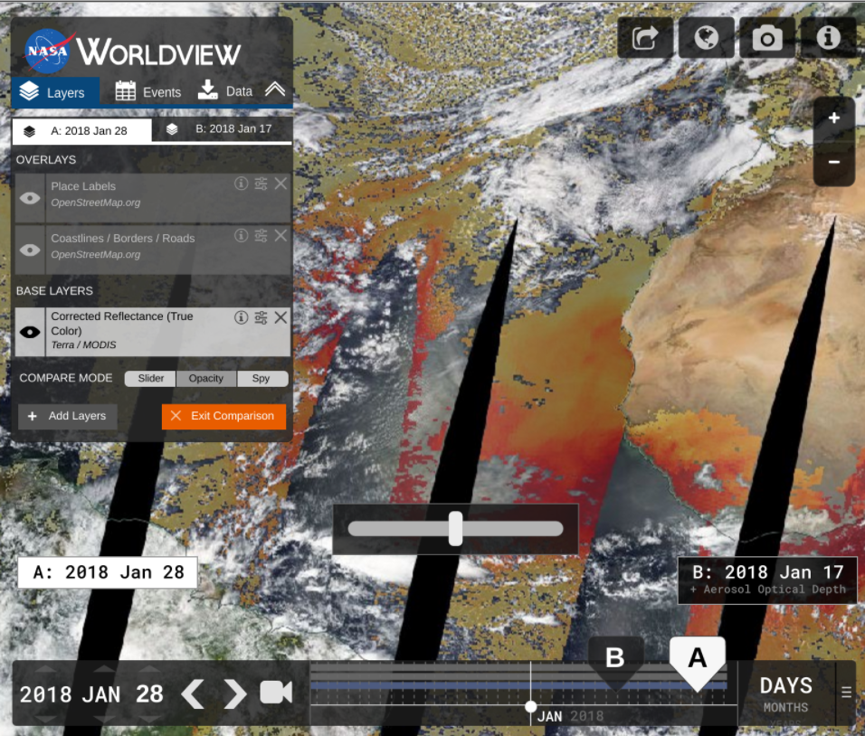
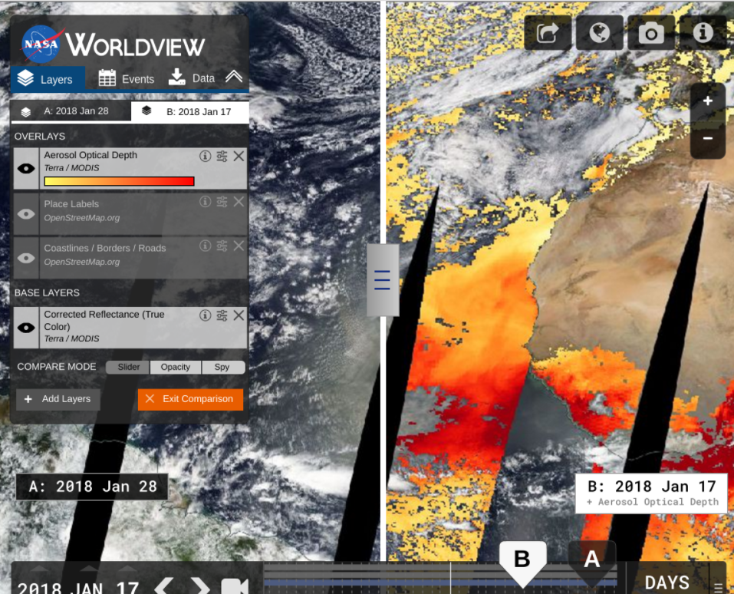
Comparison Mode (Sept 2018)
Opacity Mode
Swipe Mode

Slide 10
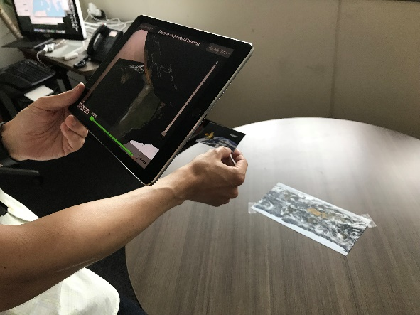
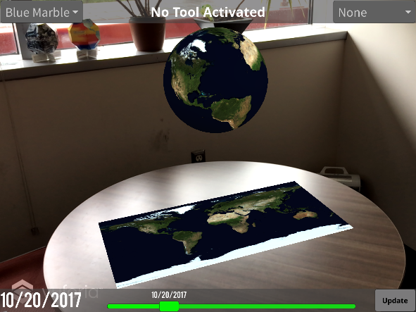
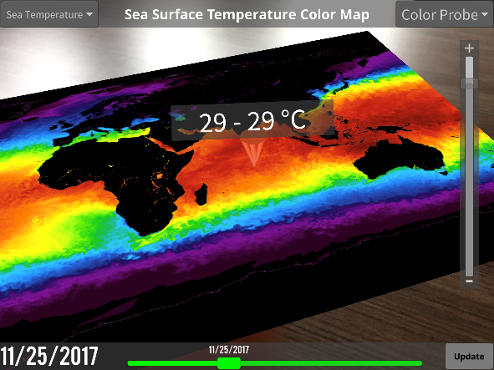
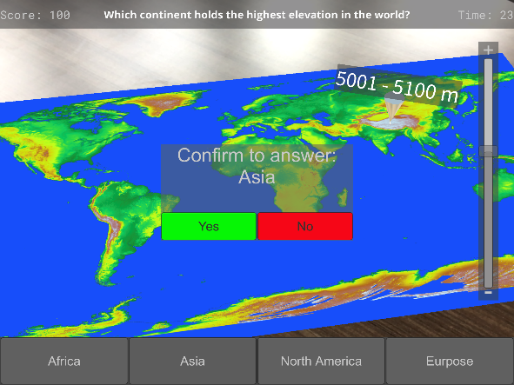
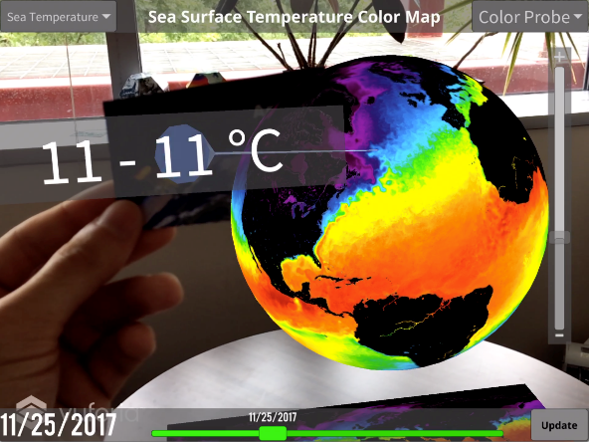
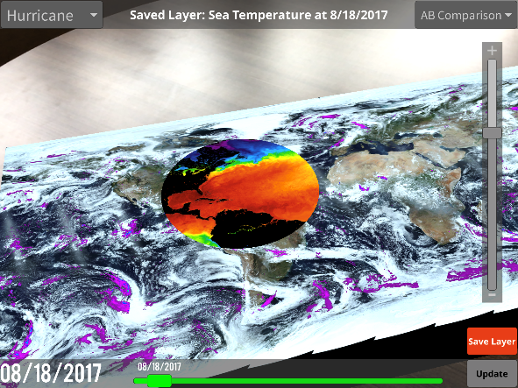
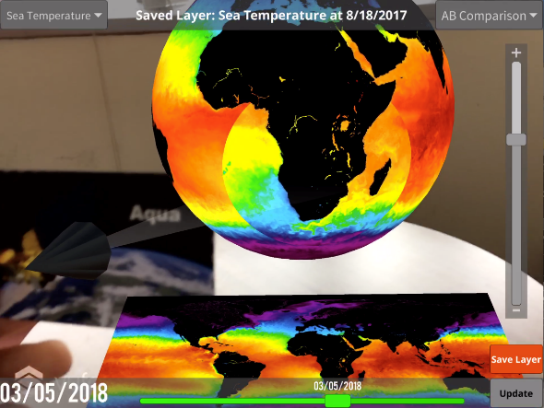
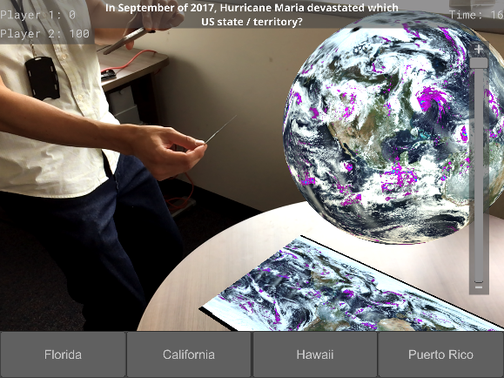
Worldview AR
Using Worldview AR
Application created by summer intern Jack Miller

Slide 11
New Layers
Over 80 new layers added since January…
SEDAC (36 Layers)* *Replaced many of the WMS layers with WMTS layers, but also added a lot more new layers that Worldview did not have before.
Croplands
Pastures
Anthropogenic Biomes
Drought Hazard
Flood Hazard
Landslide Hazard
Estimated Net Migration by Decade: 1970-1980
Estimated Net Migration by Decade: 1980-1990
Estimated Net Migration by Decade: 1990-2000
Population Density, 2000
Population Density, 2005
Population Density, 2010
Population Density, 2015
Population Density, 2020
Human Footprint
Last of the Wild
Urban Extents
Urban-Rural Extents below 10m
Probabilities of Urban Expansion, 2000-2030
Particulate Matter below 2.5µm, 2001-2010
Particulate Matter below 2.5µm, 2010-2012
Mangrove Forest Distribution, 2000
Summer Day Maximum Land Surface Temperature, 2013
Summer Night Minimum Land Surface Temperature, 2013
Ground Level Nitrogen Dioxide, 3 Years Running Mean 1996-1998
Ground Level Nitrogen Dioxide, 3 Years Running Mean 2010-2012
Amphibian Richness: All Species, Vulnerable Species, Critically Endangered Species, Endangered Species, All Threats
Mammal Richness: All Species, Vulnerable Species, Critically Endangered Species, Endangered Species, All Threats
PO.DAAC (24 layers)
Sea Surface Currents (Zonal), OSCAR
Sea Surface Currents (Meridional), OSCAR
Sea Surface Height Anomalies (GDR Cycles), TOPEX/POSEIDON, JASON-1, OSTM/Jason-2, and Jason-3
Sea Surface Height Anomalies (US West Coast, GAFECC), TOPEX/POSEIDON, JASON-1, OSTM/Jason-2
Sea Surface Currents (Zonal, US West Coast, GAFECC) , TOPEX/POSEIDON, JASON-1, OSTM/Jason-2
Sea Surface Currents (Meridional, US West Coast, GAFECC) , TOPEX/POSEIDON, JASON-1, OSTM/Jason-2
Sea Surface Height Anomalies (Reconstructed) , TOPEX/POSEIDON, JASON-1, OSTM/Jason-2
Absolute Dynamic Topography (AVISO ADT)
Liquid Water Equivalent Thickness (Mascon, CRI), GRACE Tellus
Liquid Water Equivalent Thickness (Mascon) , GRACE Tellus
Liquid Water Equivalent Thickness (Land, GFZ) , GRACE Tellus
Liquid Water Equivalent Thickness (Land, JPL) , GRACE Tellus
Liquid Water Equivalent Thickness (Land, CSR) , GRACE Tellus
Liquid Water Equivalent Thickness (Ocean, GFZ) , GRACE Tellus
Liquid Water Equivalent Thickness (Ocean, JPL) , GRACE Tellus
Liquid Water Equivalent Thickness (Ocean, CSR) , GRACE Tellus
Liquid Water Equivalent Thickness (Ocean, EOF, GFZ) , GRACE Tellus
Liquid Water Equivalent Thickness (Ocean, EOF, JPL) , GRACE Tellus
Liquid Water Equivalent Thickness (Ocean, EOF, CSR) , GRACE Tellus
Sea Surface Salinity (L3, Monthly, Radiometer), SMAP
Sea Surface Salinity (L3, 8-Day Running Mean, Radiometer), SMAP
Sea Surface Salinity (L3, CAP, Monthly), SMAP
Sea Surface Salinity (L3, CAP, 8-Day Running Mean), SMAP
Sea Surface Temperature (L4), GHRSST
AMSR2 LPRM (4 Layers)
Surface Soil Moisture C1-Band (Night, Daily)
Surface Soil Moisture C1-Band (Day, Daily)
Downscaled Surface Soil Moisture C1-Band (Night, Daily)
Downscaled Surface Soil Moisture C1-Band (Day, Daily)
GHRC LIS (4 Layers)
TRMM LIS Flash Radiance (Level 2, Standard)
Calibrated Flash Radiance (OTD / Microlab-1)
DMSP-F12 OLS Digital Derived Lightning (Level 3)
DMSP-F10 OLS Digital Derived Lightning (Level 3)
SMAP Geographic (4 Layers)
Freeze/Thaw, Day (L3, Passive, Radiometer)
Freeze/Thaw, Night (L3, Passive, Radiometer)
Freeze/Thaw, Day (L3, Passive Enhanced, Radiometer)
Freeze/Thaw, Night (L3, Passive Enhanced, Radiometer)
Orbit tracks (12 layers)
Landsat 7 Orbital Tracks (Ascending/Night)
Landsat 7 Orbital Tracks (Descending/Day)
Sentinel-2A Orbital Track (Descending/Day)
Sentinel-2A Orbital Track (Ascending/Night)
Sentinel-2B Orbital Track (Descending/Day)
Sentinel-2B Orbital Track (Ascending/Night)
Sentinel-5P Orbital Track (Descending/Night)
Sentinel-5P Orbital Track (Ascending/Day)
NOAA-20 Orbital Tracks (Ascending/Day)
NOAA-20 Orbital Tracks (Descending/Night)

Slide 12
New Layers
…and 30 more in our next release!
MERRA-2 (cont.)
- Total Aerosol Optical Thickness Extinction 550nm (Monthly)
- Total Dust Deposition, Dry+Wet Bins (Monthly)
- Evaporation from Turbulence (Monthly)
- Surface Albedo (Monthly)
- Carbon Monoxide Emission ENSEMBLE (Monthly)
- ISCCP Cloud Albedo (Monthly)
- Snow Depth Over Glaciated Surface (Monthly)
- Open Water Latent Energy Flux (Monthly)
- Total Precipitable Water Vapor (Monthly)
- 2 meter Air Temperature, Assimilated (Monthly)
- Aerosol Optical Depth Analysis (Monthly)
- Surface Wind Speed (Monthly)
- Air Temperature at 250hPa (Monthly)
- Ozone Mixing Ratio at 50hPa (Monthly)
- Relative Humidity after Moist at 700hPa (Monthly)
- Convective Rainwater Source at 700hPa (Monthly)
OMPS (1 layer)
- Aerosol Index (PyroCumuloNimbus)
AMSR2 (4 layers)
- Sea Ice Concentration (12 km), AMSR2, Unified algorithm
- Sea Ice Concentration (25 km), AMSR2, Unified algorithm
- Brightness Temperature for Sea ice (89H GHz), ASMR2, Unified algorithm
- Brightness Temperature for Sea ice (89V GHz), ASMR2, Unified algorithm
MERRA-2 (25 layers)
- 2m Air Temperature (Monthly)
- Total Precipitation Bias Corrected (Monthly)
- Snowfall (Monthly)
- Soil Water Root Zone (Monthly)
- Evaporation over Land (Monthly)
- SO2 Column Mass Density ENSEMBLE (Monthly)
- Dust Surface Mass Concentration PM2.5 (Monthly)
- Dust Surface Mass Concentration (Monthly)
- Total Aerosol Optical Thickness Scattering 550nm (Monthly)

Slide 13
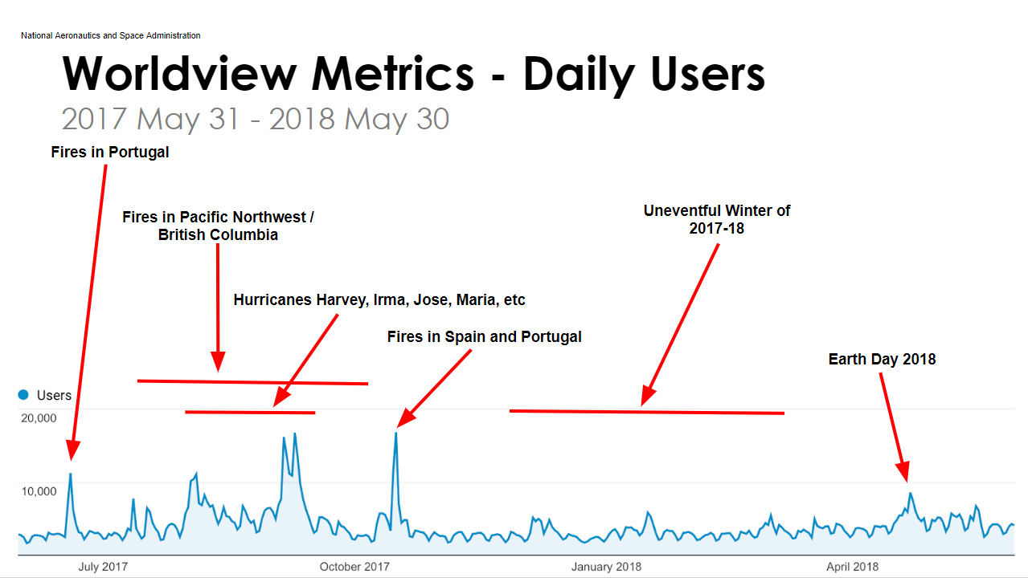
Metrics

Slide 14
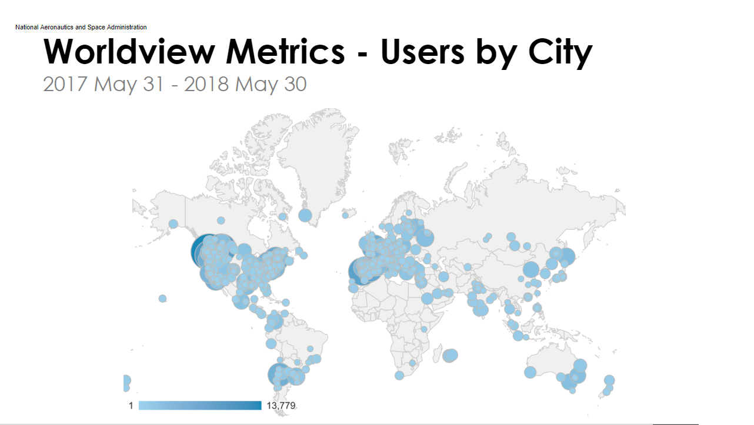
Metrics

Slide 15
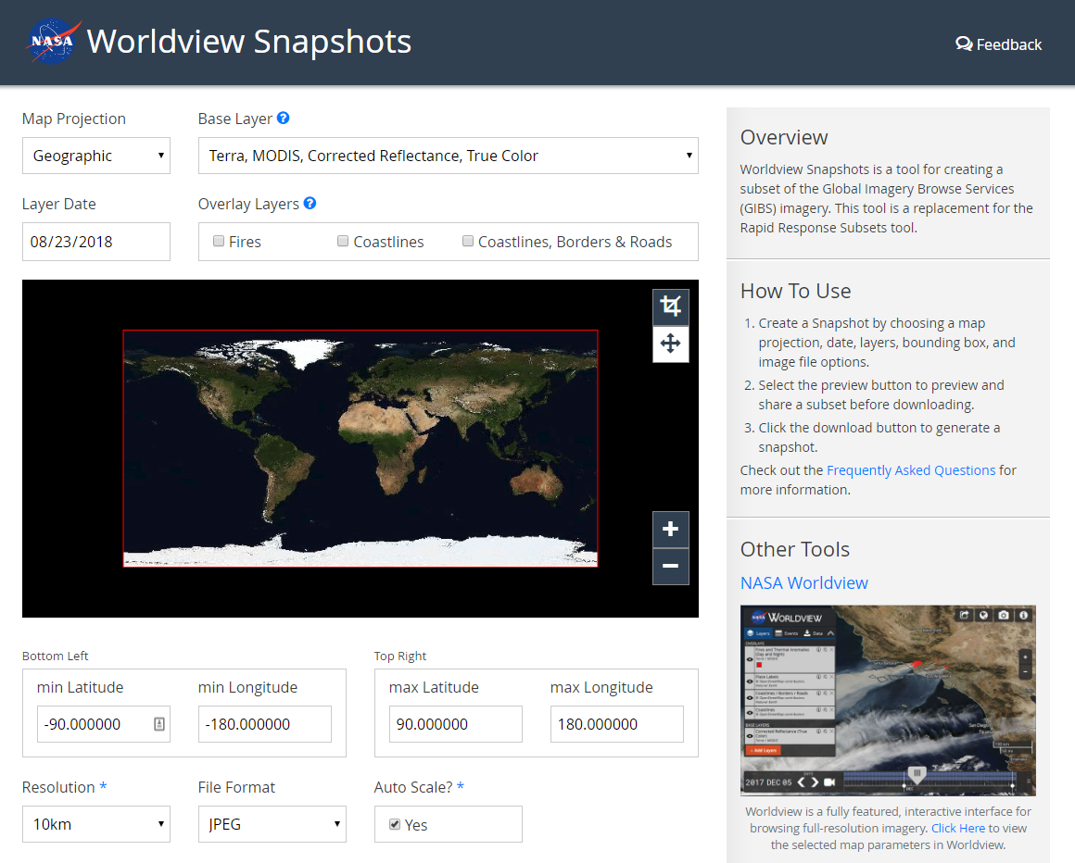
Short-Term Goals
Worldview Snapshots Tool
Startup Tour/Tutorial
Show users new / popular events
Advanced Vector Support
Styling based on vector features
Vector point tooltips
Revamped Image Download
Capture imagery across the dateline
Vector download capabilities
Add additional meta to downloads (legends, color bars, time stamps, etc.)
Updates to OpenStreetMap Layers

Slide 16
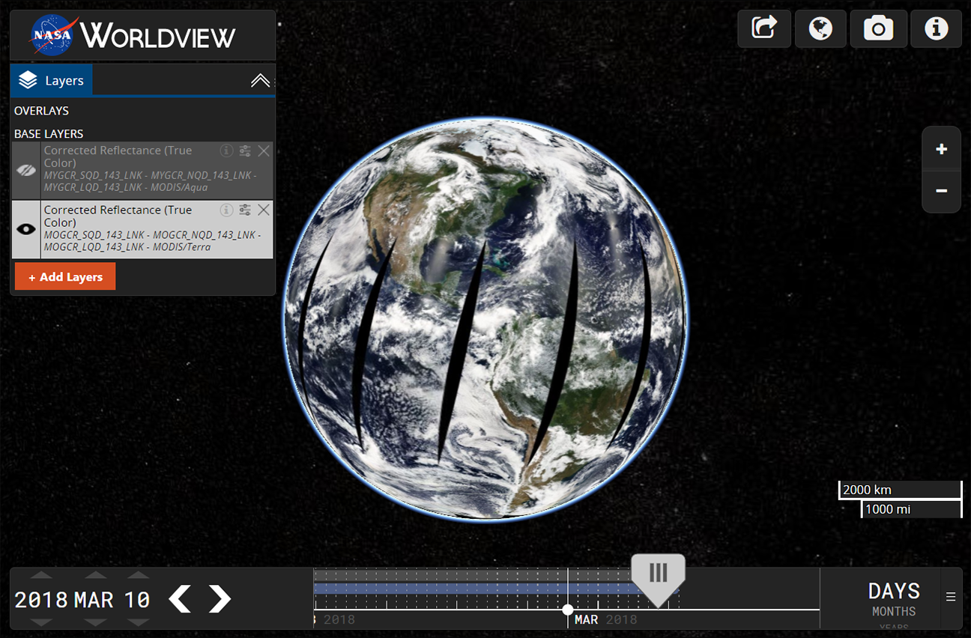
Mid to Long-Term Goals
Historical Event Browsing
Migration to NGAP
UI Overhaul
Improved Data Download
Improved Timeline
Gazetteer / Omni search box
Search for places, lat/long, layers, etc.
User Customization
Save settings, bookmarks, etc.
Crowdsource event information
Virtual Globe / Data Curtains
Add features that support new missions…
Worldview 3D globe concept using Cesium

Slide 17
Thank You
More Resources & Links
Worldview on GitHub: https://github.com/nasa-gibs/worldview Release Notes: https://github.com/nasa-gibs/worldview/releases Project Roadmap: https://github.com/nasa-gibs/worldview/projects/7

